Slide 1
Chapter 4 Objectives
The CCNA Topics Covered in this chapter include:
  What is NAT overload?
  PAT working example
  PAT configuration
  Verifying NAT and PAT

Slide 2


PAT – Port Address Translation
Overloading an inside global address
NAT overload only one global IP shared among all hosts
200.0.0.1:1025
A
10.0.0.1
200.0.0.1:1026
200.0.0.1:1027
B
10.0.0.2
10.0.0.254
200.0.0.1
Internet
E0
C
10.0.0.3
Shared Global IP

Slide 3
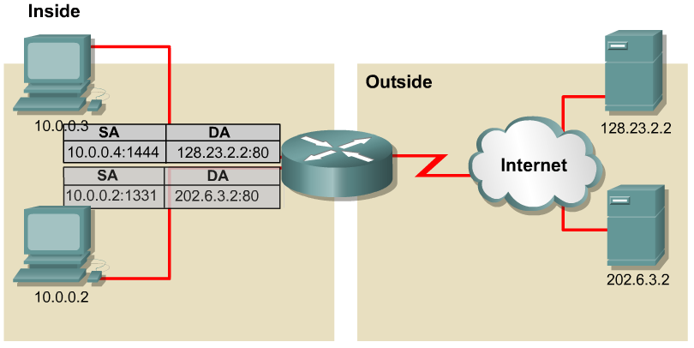
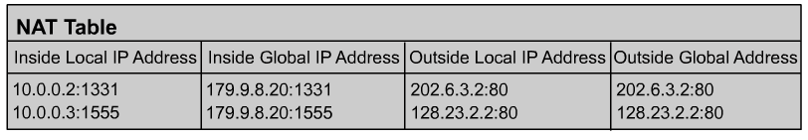
PAT – Port Address Translation
PAT (Port Address Translation) allows you to use a single Public IP address and assign it up to 65,536 inside hosts (4,000 is more realistic).
PAT translates and records the TCP/UDP source port address to track inside Host addresses.

Slide 4
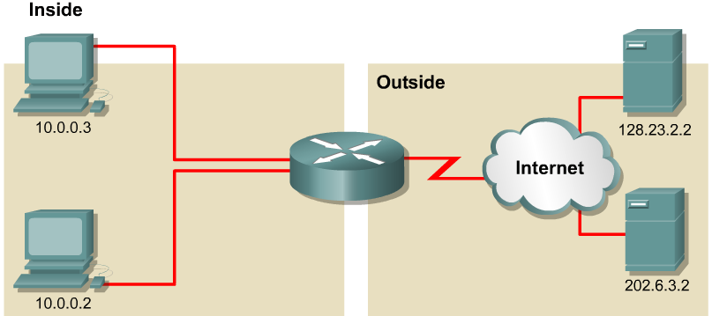
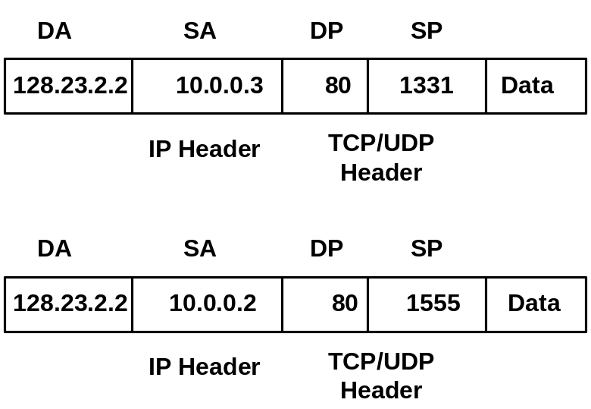
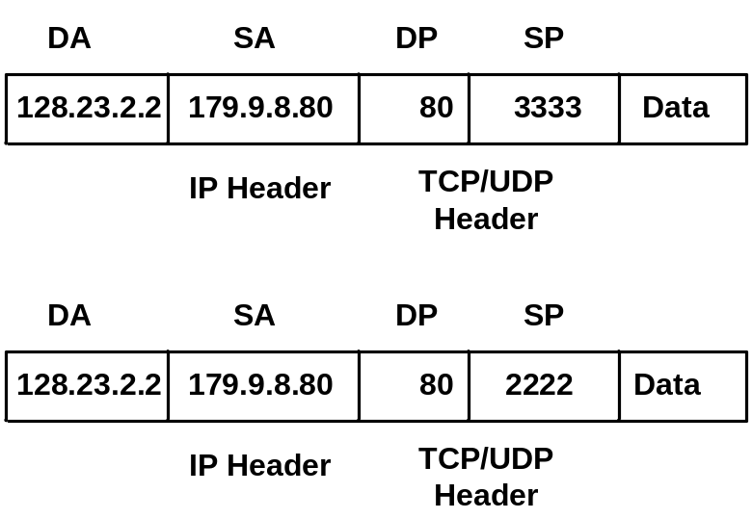
PAT Example
NAT/PAT table maintains translation of:
DA, SA, SP
1
2
1
2

Slide 5
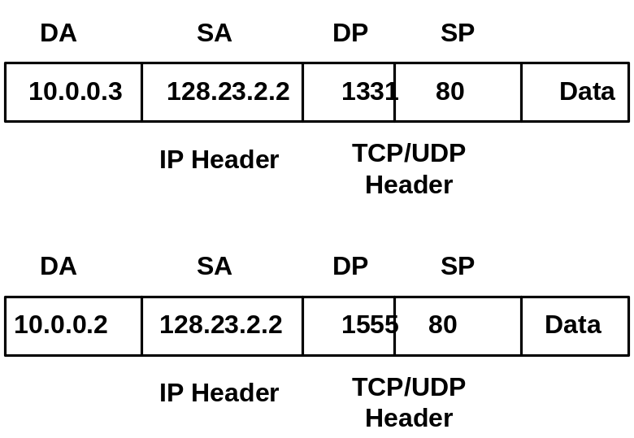
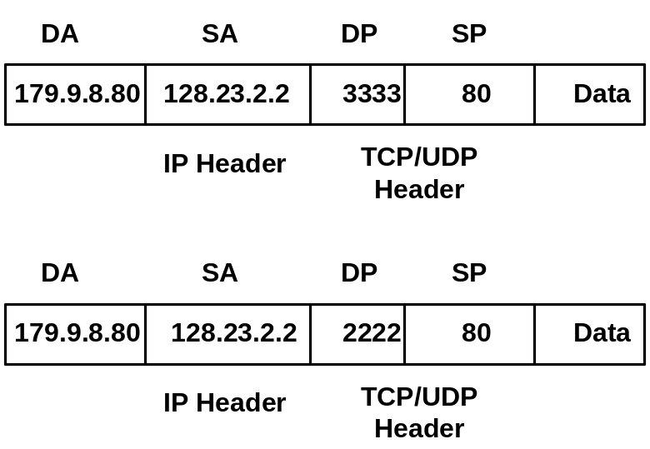
PAT Example
NAT/PAT table maintains translation of:
SA (DA), DA (SA), DP (SP)
4
3
4
3

Slide 6
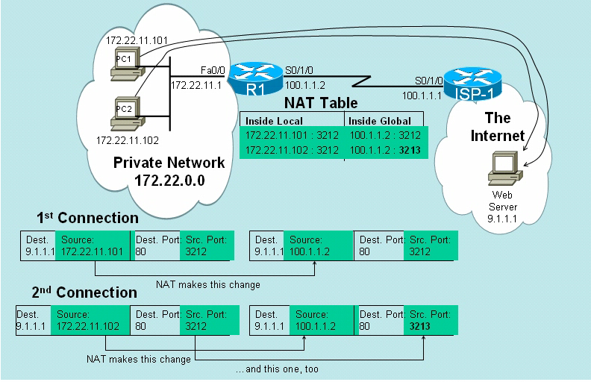
PAT Example

Slide 7
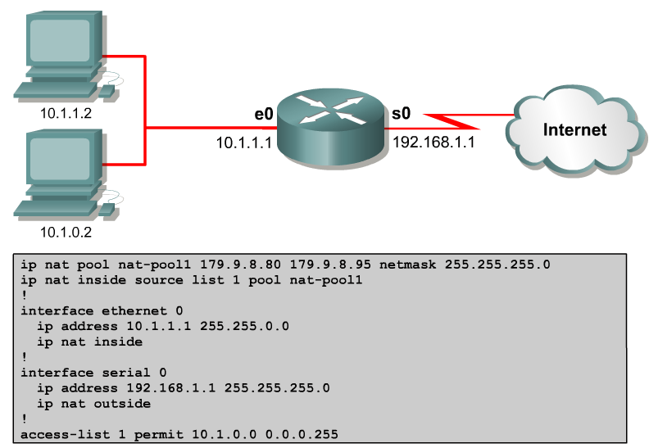
Configuring Dynamic NAT with PAT
Translate to these outside addresses
Overload
Source IP address must match here

Slide 8
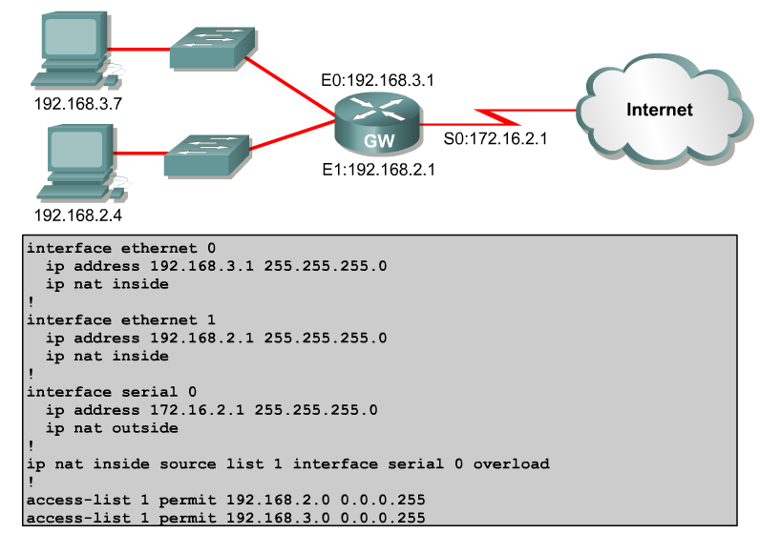
Configuring Dynamic NAT with PAT (Scenario#2)
This is a different example, using the IP address of the outside interface instead specifying a pool of inside-global IP addresses

Slide 9
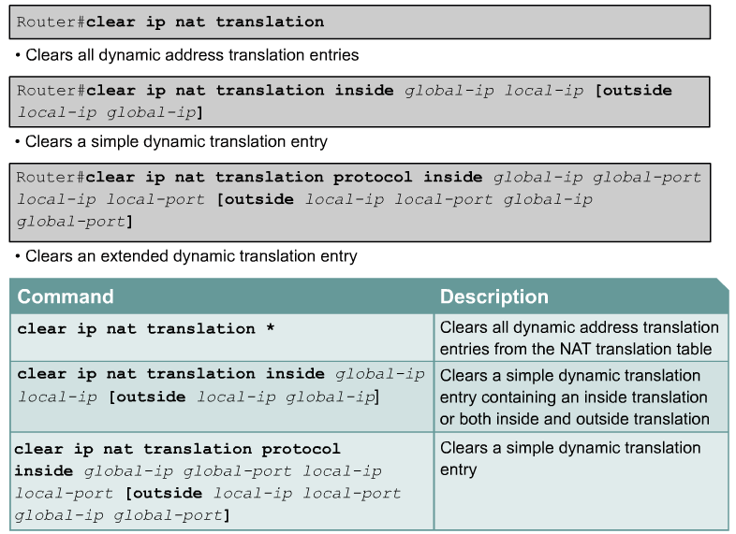
NAT/PAT Clear Commands
Static Entries will not be deleted.
Otherwise, it will time out after 24 hours
Dynamic NAT without PAT-default is 24 hours
Dynamic NAT with PAT- default is a period of nonuse
Mistake: Should be Extended instead of Simple

Slide 10
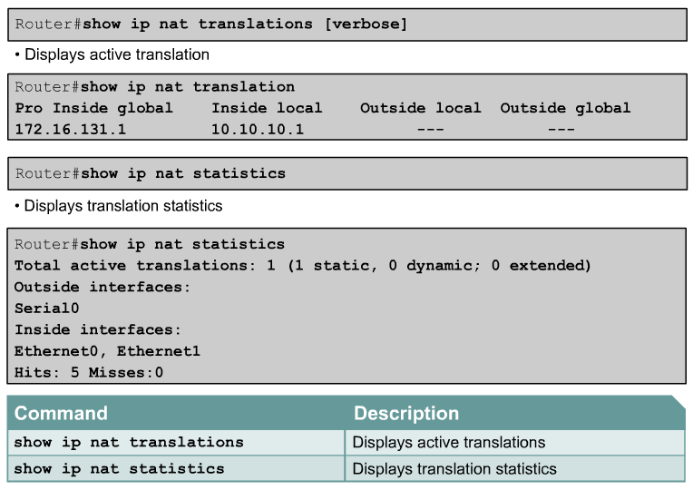
Verifying NAT/PAT

